Slide 1

Pandiyan Murugan
Sr. Software Engineer @ Kovai.co
Building Secure Solutions with Azure SQL DB
Notes:
Microsoft announced 25 major updates and new features in Azure in this conference

Slide 2
How?
Server-level and database-level firewall rules
Configure an Azure Active Directory (AD) administrator
Manage user access with SQL authentication, Azure AD authentication, and secure connection strings
Enable security features, such as advanced data security, auditing, data masking, and encryption

Slide 3
Azure SQL Database secures data in a single or pooled database by allowing you to:
Limit access using firewall rules
Use authentication mechanisms that require identity
Use authorization with role-based memberships and permissions
Enable security features

Slide 4
Create firewall rules
SQL databases are protected by firewalls in Azure. By default, all connections to the server and database are rejected.
Set Allow access to Azure services to OFF for the most secure configuration. Then, create a reserved IP (classic deployment) for the resource that needs to connect, such as an Azure VM or cloud service, and only allow that IP address access through the firewall. If you're using the resource manager deployment model, a dedicated public IP address is required for each resource.

Slide 5
Set up SQL Database server firewall rules

Slide 6
Firewall rules
Server-level firewall rules
Allow access to Azure services
IP address rules
Virtual network rules
Database-level firewall rules
IP address rules

Slide 7
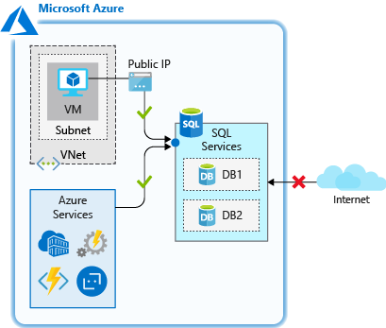
Allow access to Azure services

Slide 8
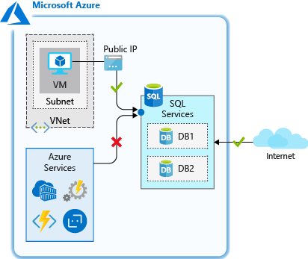
IP address rules

Slide 9
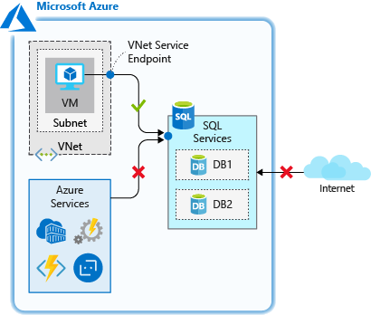
Virtual network rules

Slide 10
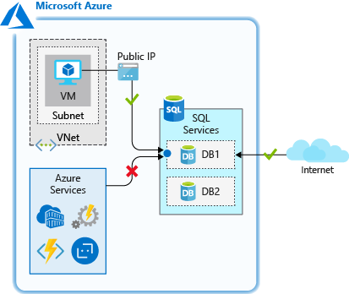
Database-level firewall rules

Slide 11
Control who can access your database
SQL authentication, use a username and password for logins and are only valid in the context of a specific database within the server
Azure AD authentication, use identities managed by Azure AD

Slide 12
SQL authentication
CREATE
CREATE USER ApplicationUser WITH PASSWORD = 'YourStrongPassword1’;
ALTER
ALTER ROLE db_datareader ADD MEMBER ApplicationUser;
ALTER
ALTER ROLE db_datawriter ADD MEMBER ApplicationUser;

Slide 13

Azure AD authentication
To add a user with Azure AD authentication:
Connect to your Azure SQL server using an Azure AD account with at least the ALTER ANY USER permission.
In the query window, enter the following command and modify <Azure_AD_principal_name> to the principal name of the Azure AD user or the display name of the Azure AD group:
CREATE USER <Azure_AD_principal_name> FROM EXTERNAL PROVIDER;

Slide 14
Secure connection strings
To ensure a secure, encrypted connection between the client application and SQL database, a connection string must be configured to:
Request an encrypted connection
Not trust the server certificate

Slide 15
Dynamic data masking
Data masking rules consist of the column to apply the mask to, and how the data should be masked.

Slide 16
Advanced data security
The advanced data security feature detects potential threats as they occur and provides security alerts on anomalous activities.
Users can explore these suspicious events using the auditing feature, and determine if the event was to access, breach, or exploit data in the database.

Slide 17
Thank you

